Slide 1
CareWing
Presented By:
Indrayani 002244903
Lok Venkatesh Vasamsetti 002815412
Rishika Harish 002475133
Srivardhan Karnam 002481120

Slide 2
About CareWing
Empowering Education: Connects volunteers with NGOs to teach and enhance education locally.
Sustainable Giving: Facilitates donations of goods to support children and promote sustainability.
Transparent Fundraising: Offers a module for NGOs to transparently showcase and fundraise for their needs.

Slide 3







Tech Stack
Front-end :
Back-end :

Slide 4
Features
NGO Registration: Allows NGOs to register, manage their profile, and post fundraising campaigns.
Fundraising Visibility: NGOs can display active campaigns, track contributions in real-time, and see remaining funding needs.
Volunteer Opportunities: NGOs can post requests for volunteers, manage applications, and confirm volunteers directly through the platform.
Donation Management: NGOs can receive, track, and accept donated goods, sending confirmation emails to donors.
User Contributions: Users can log in to donate goods, specify availability for volunteering, and contribute financially to campaigns.
User Activity Tracking: Enables users to view their past donations and volunteering history, and explore current NGO needs for volunteers and donations.

Slide 5
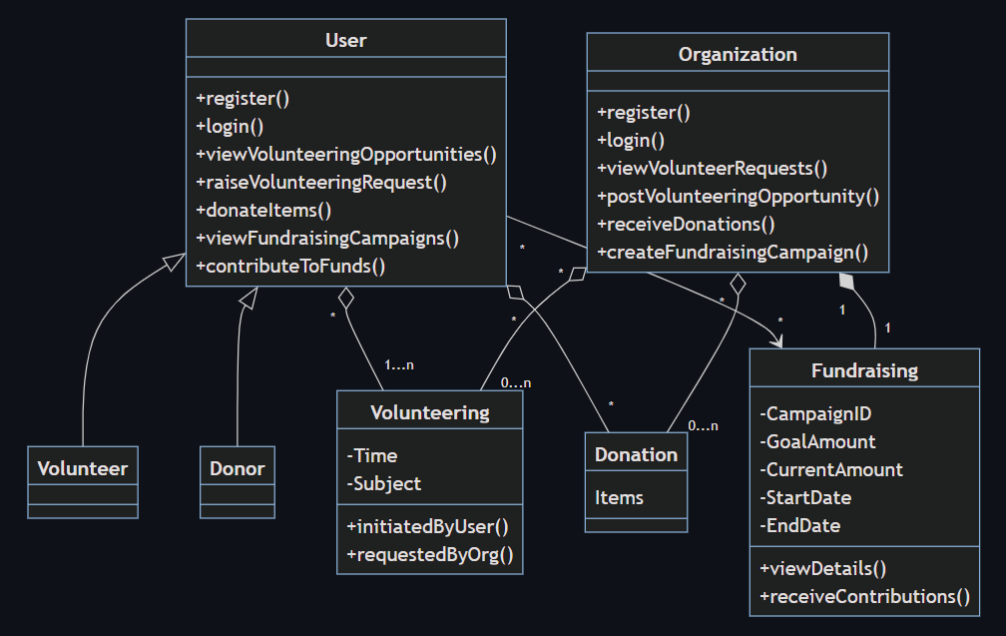
Domain Model

Slide 6
Contributions made
Indrayani
UI Design - Volunteer, Pop-ups, Page Redirections(SignUp & Login)
Domain Model, Rest API Skeleton, CRUD pop up
Lok Venkatesh Vasamsetti
UI Design - Home Pages, Fund Status
Backend - Login, SignUp, GET method Routes & Fund Status
Rishika Harish
UI Design & Styling, User Experience Enhancement
Backend - Donations and Volunteer Opportunities functionalities
Srivardhan Karanam
Redux Implementation, Routes, MongoDB
Backend - Fund Raise and Volunteer(User side)

Slide 7
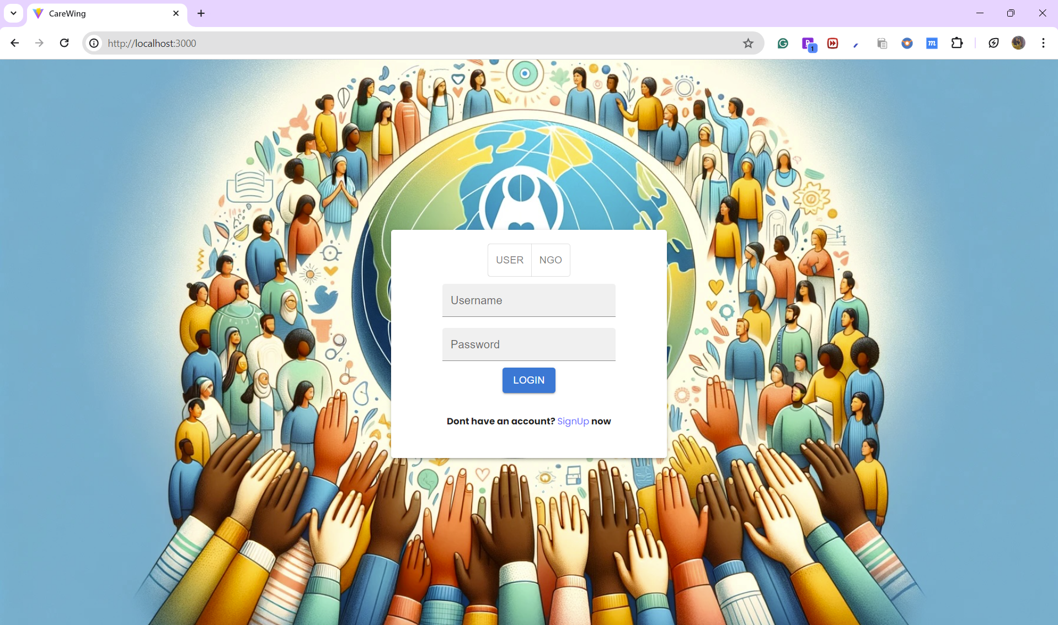

Slide 8
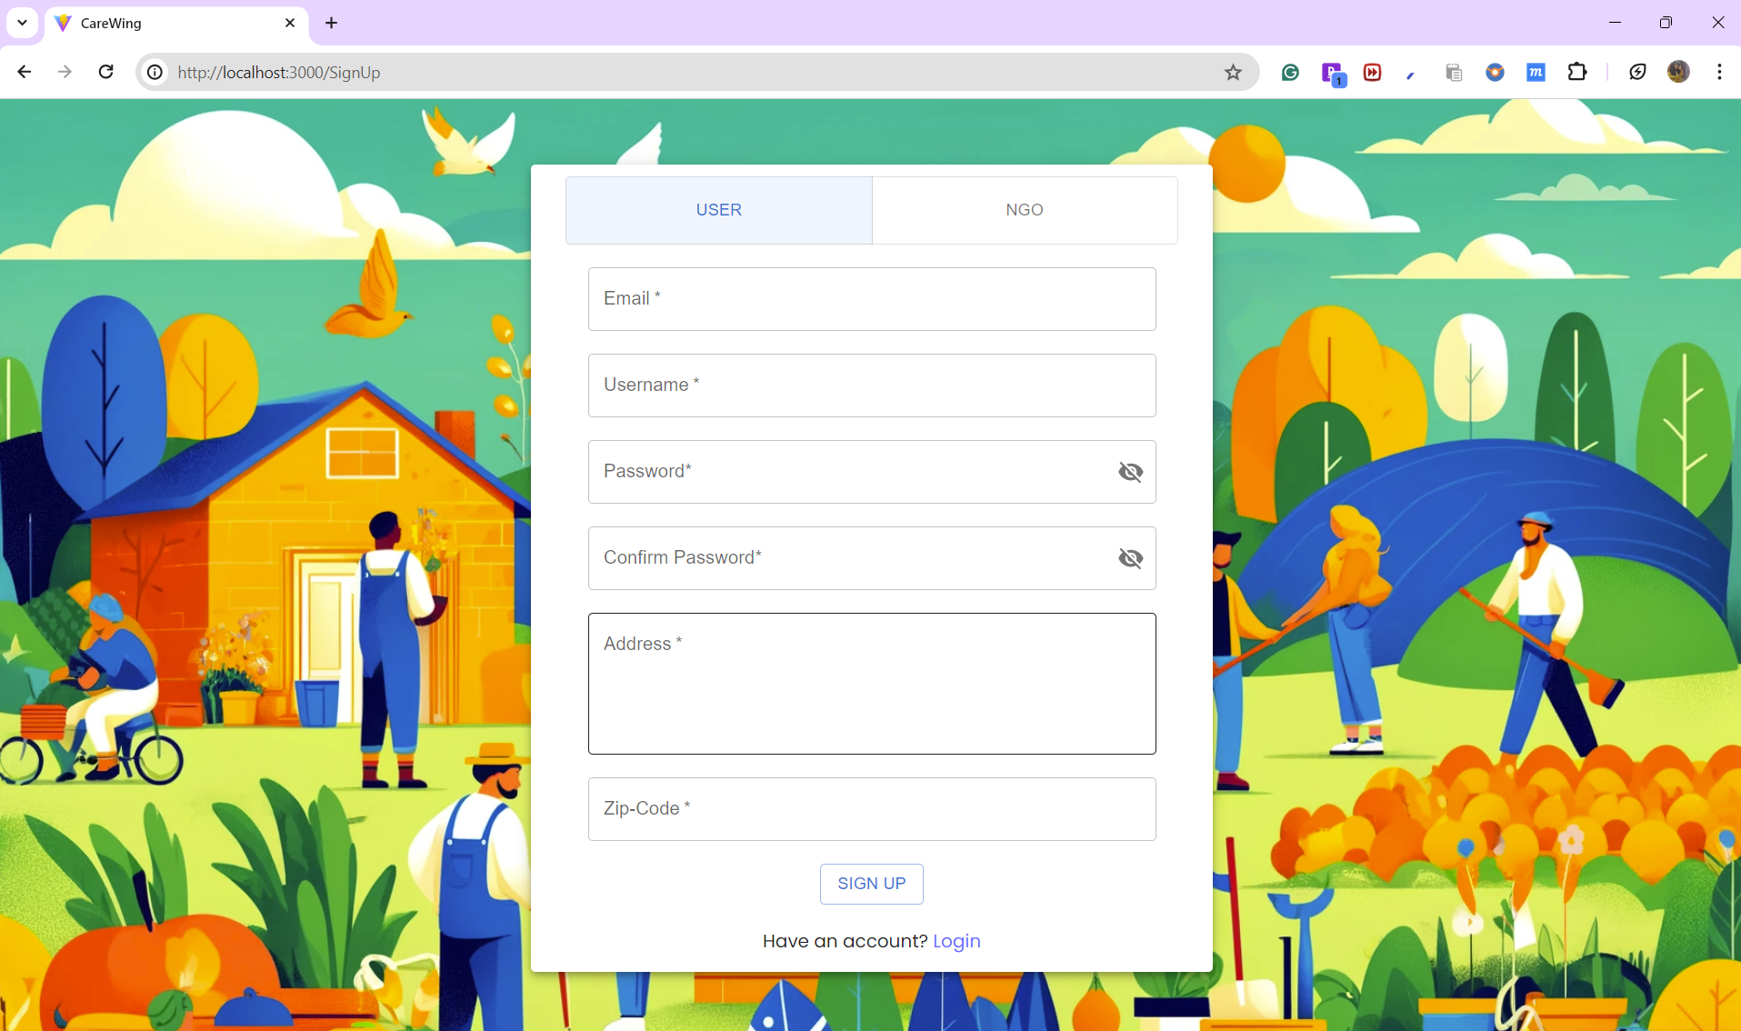

Slide 9
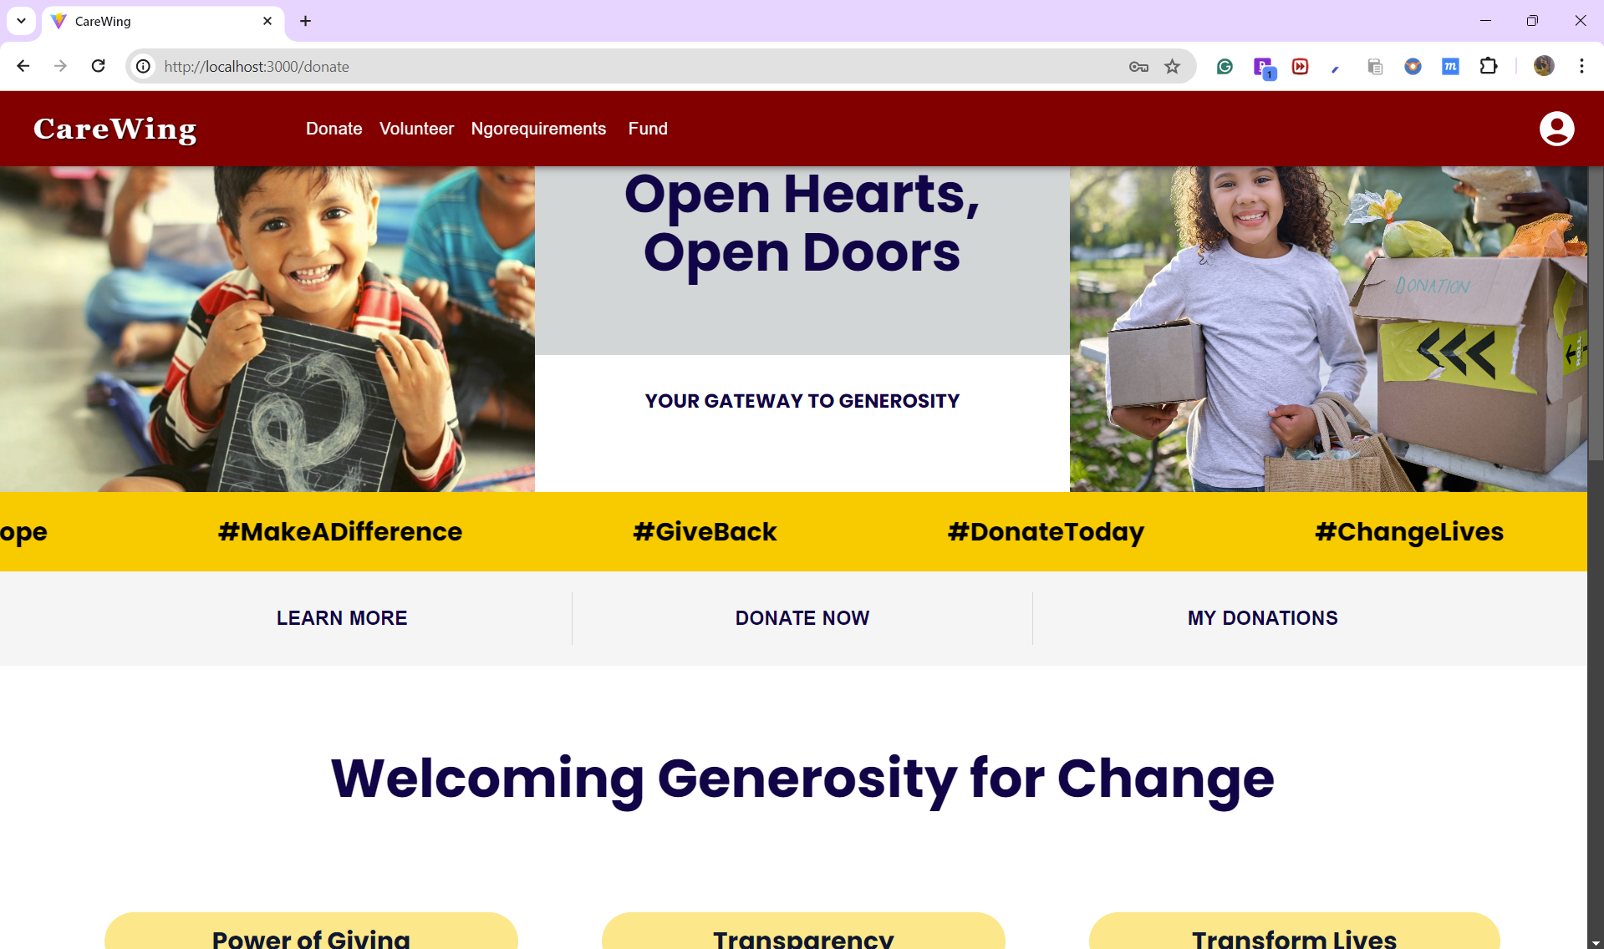
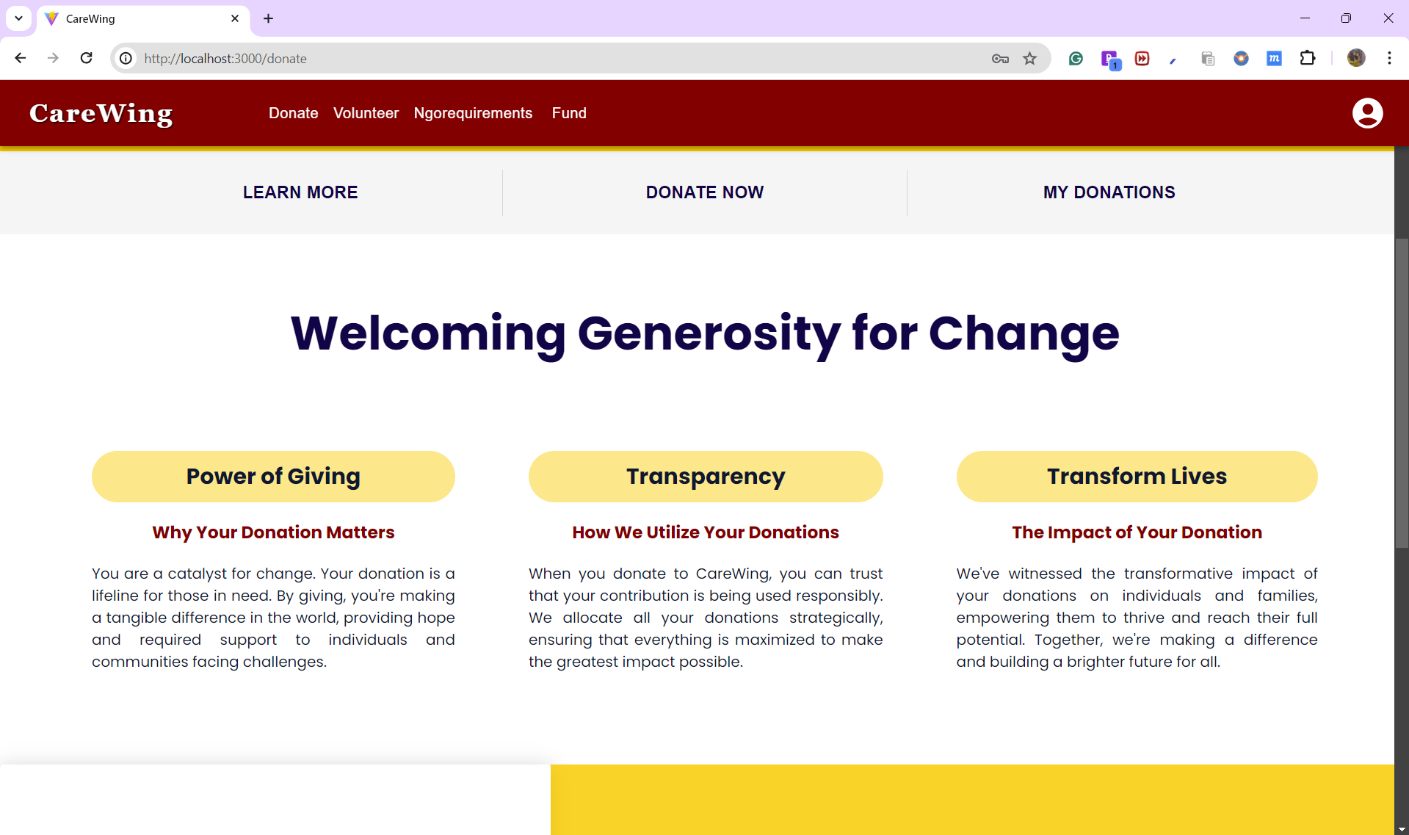
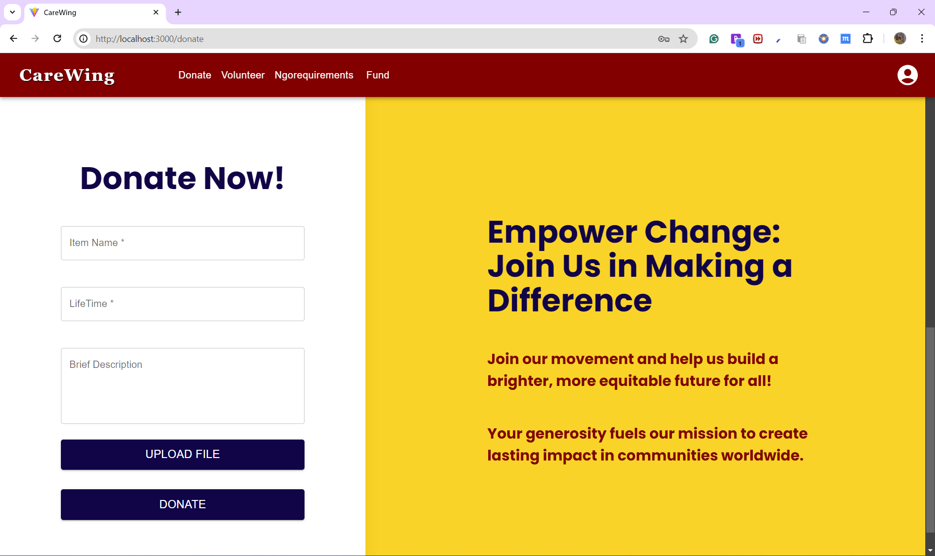

Slide 10
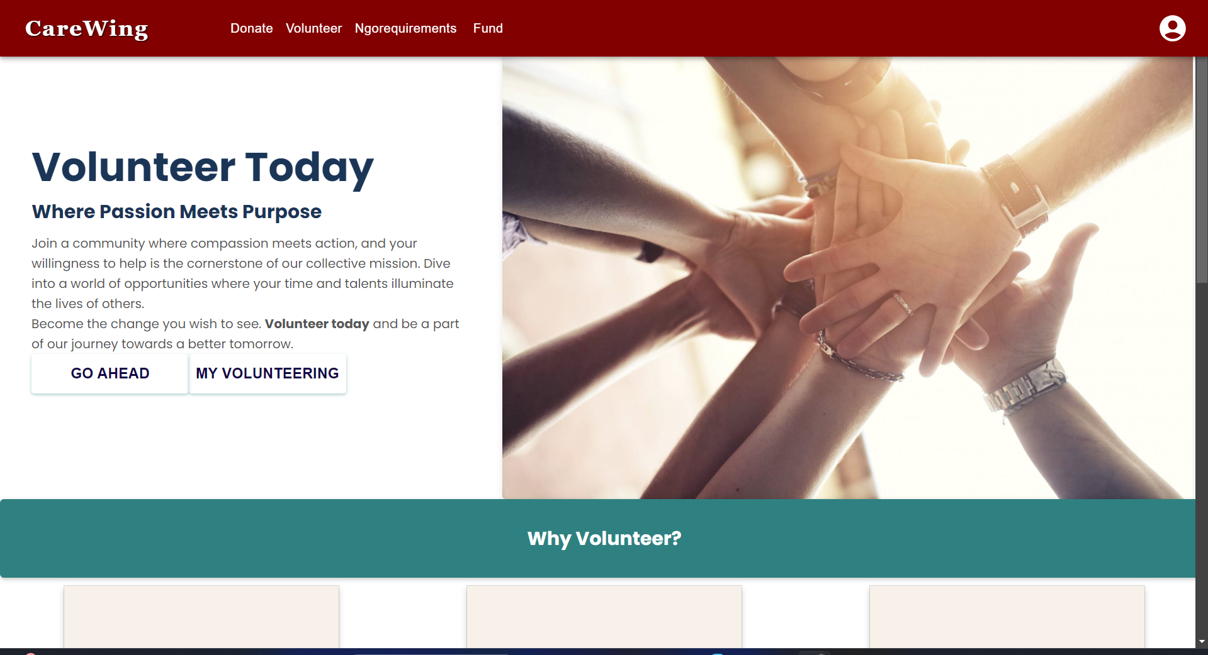
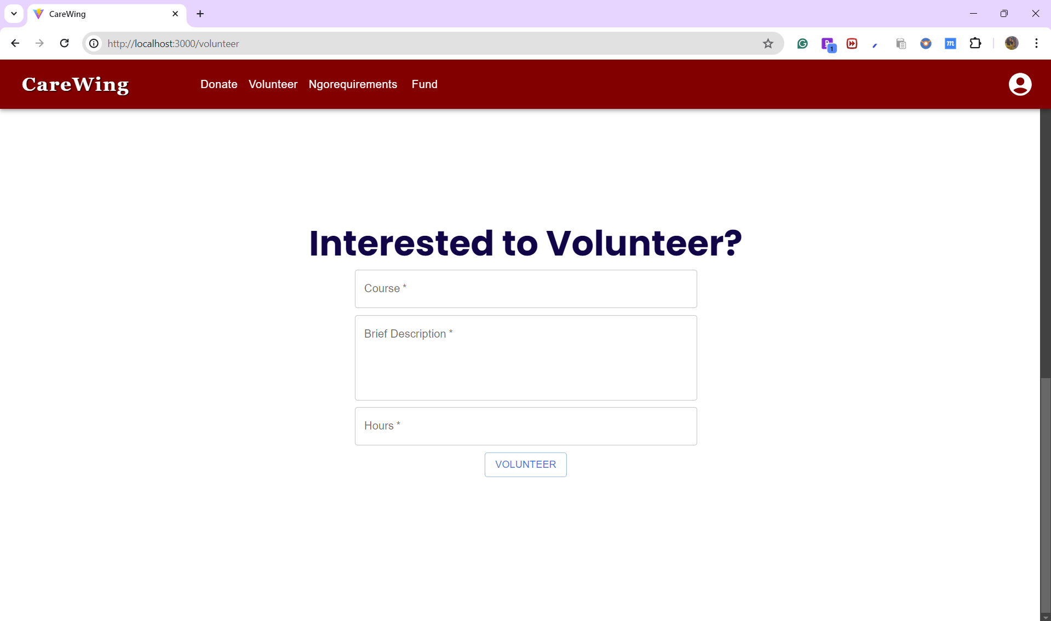
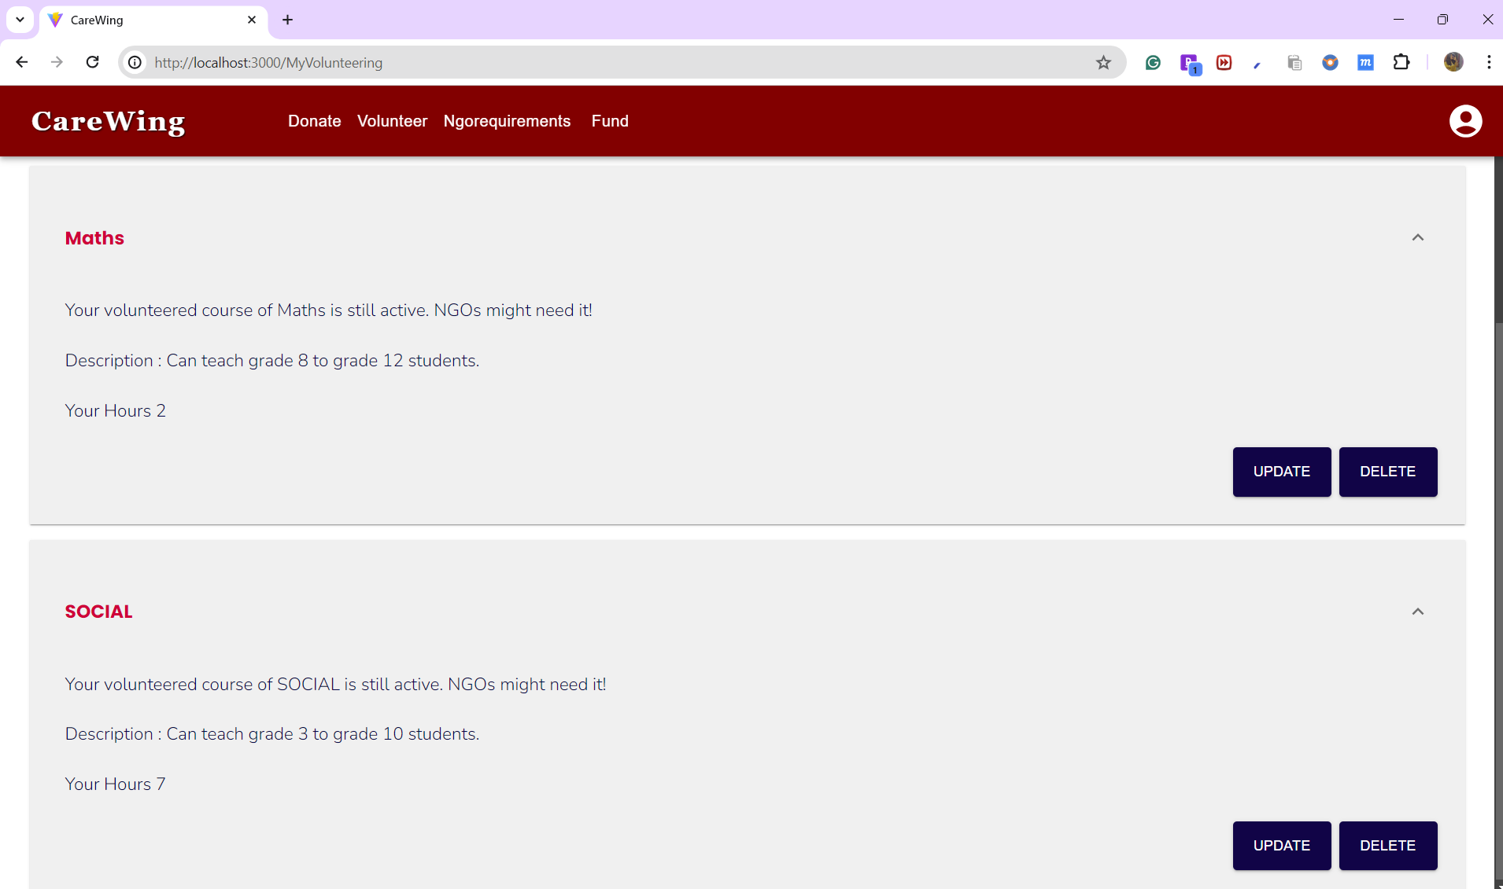

Slide 11
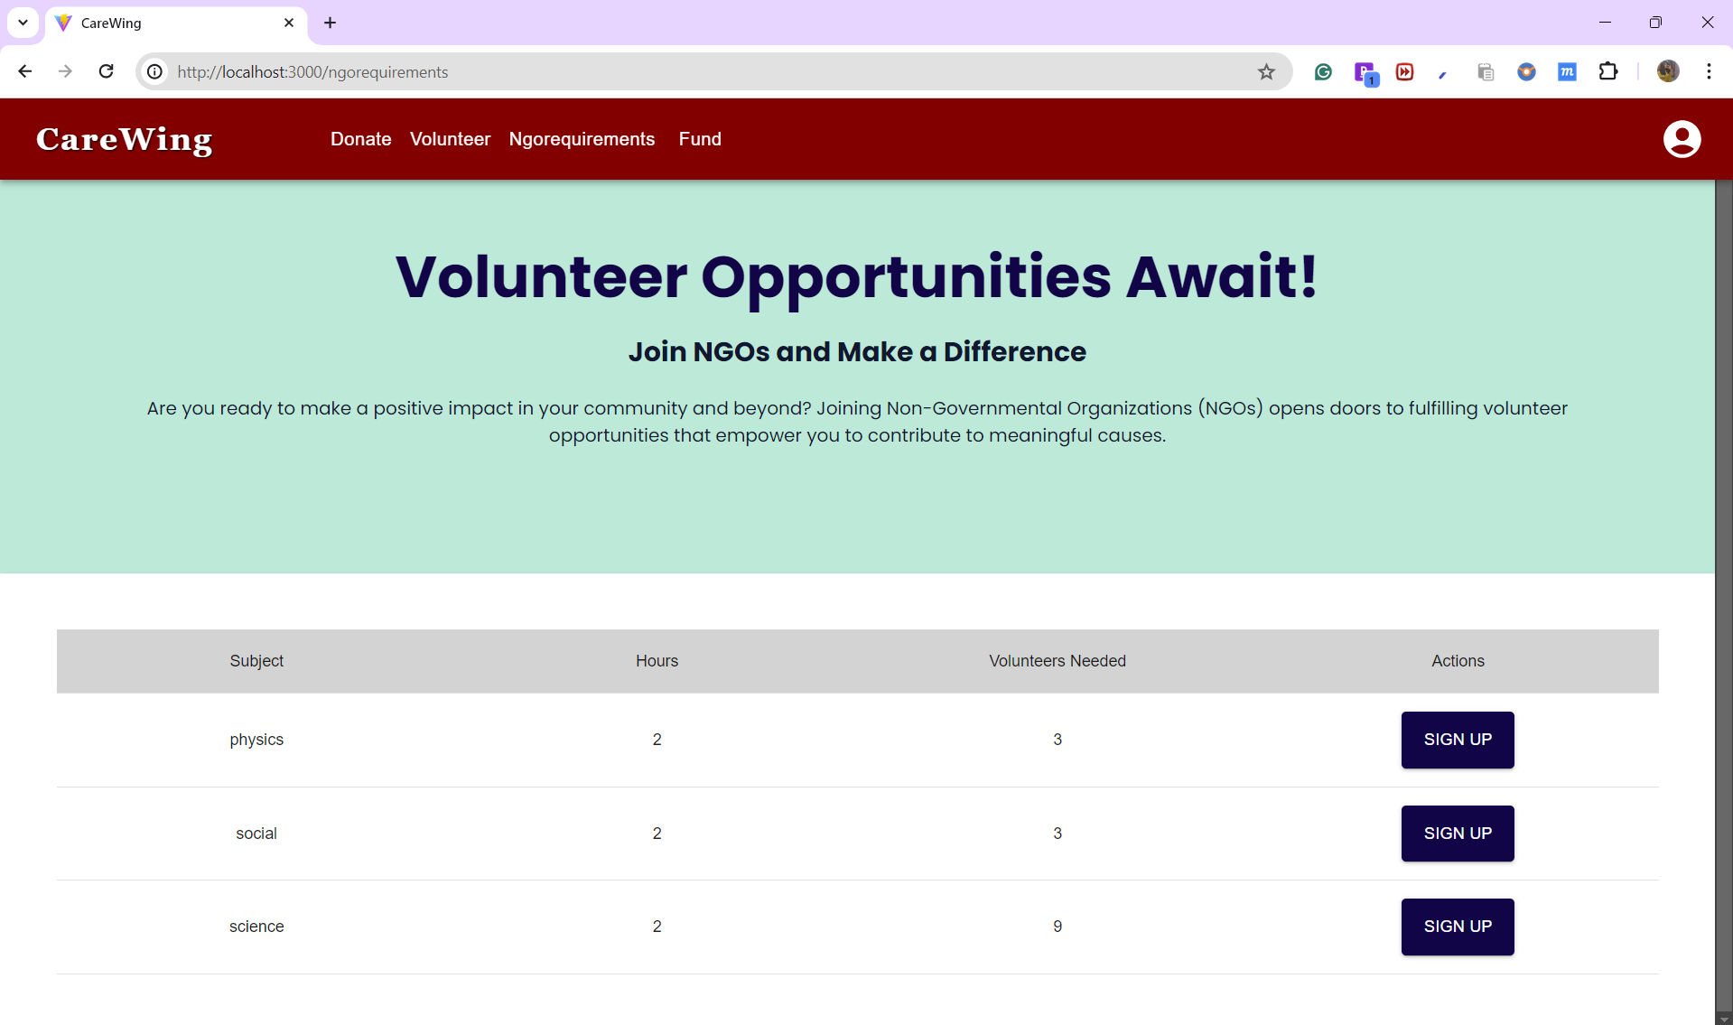

Slide 12
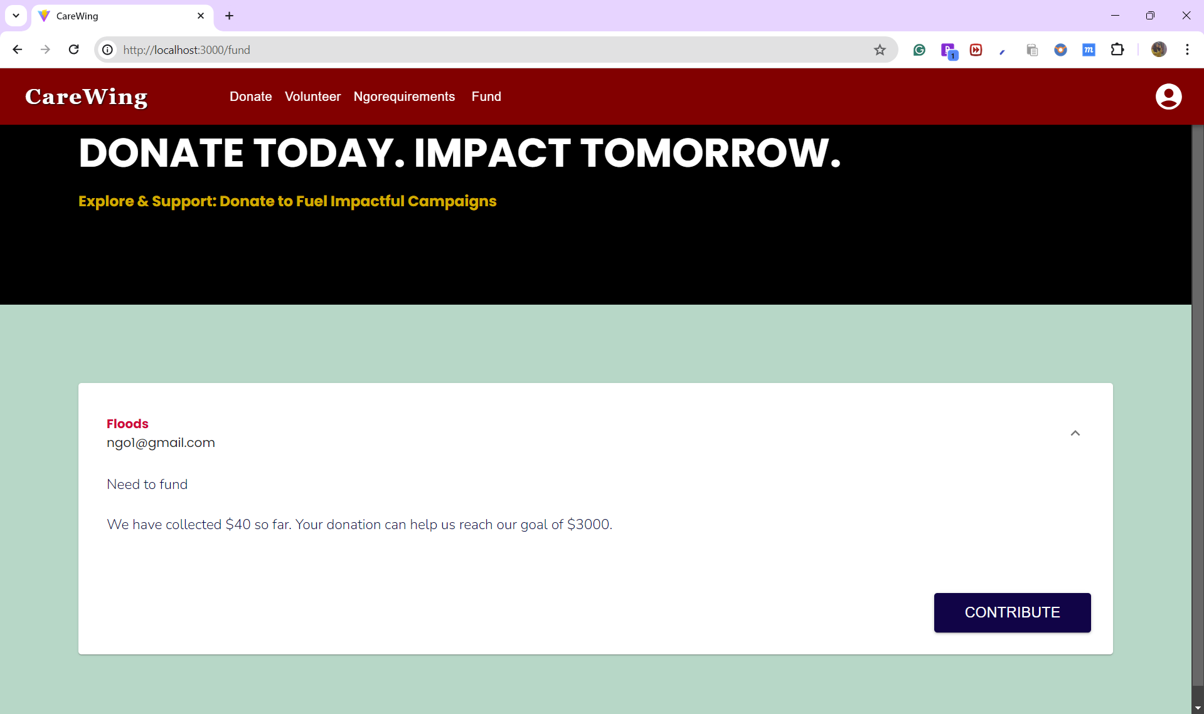

Slide 13
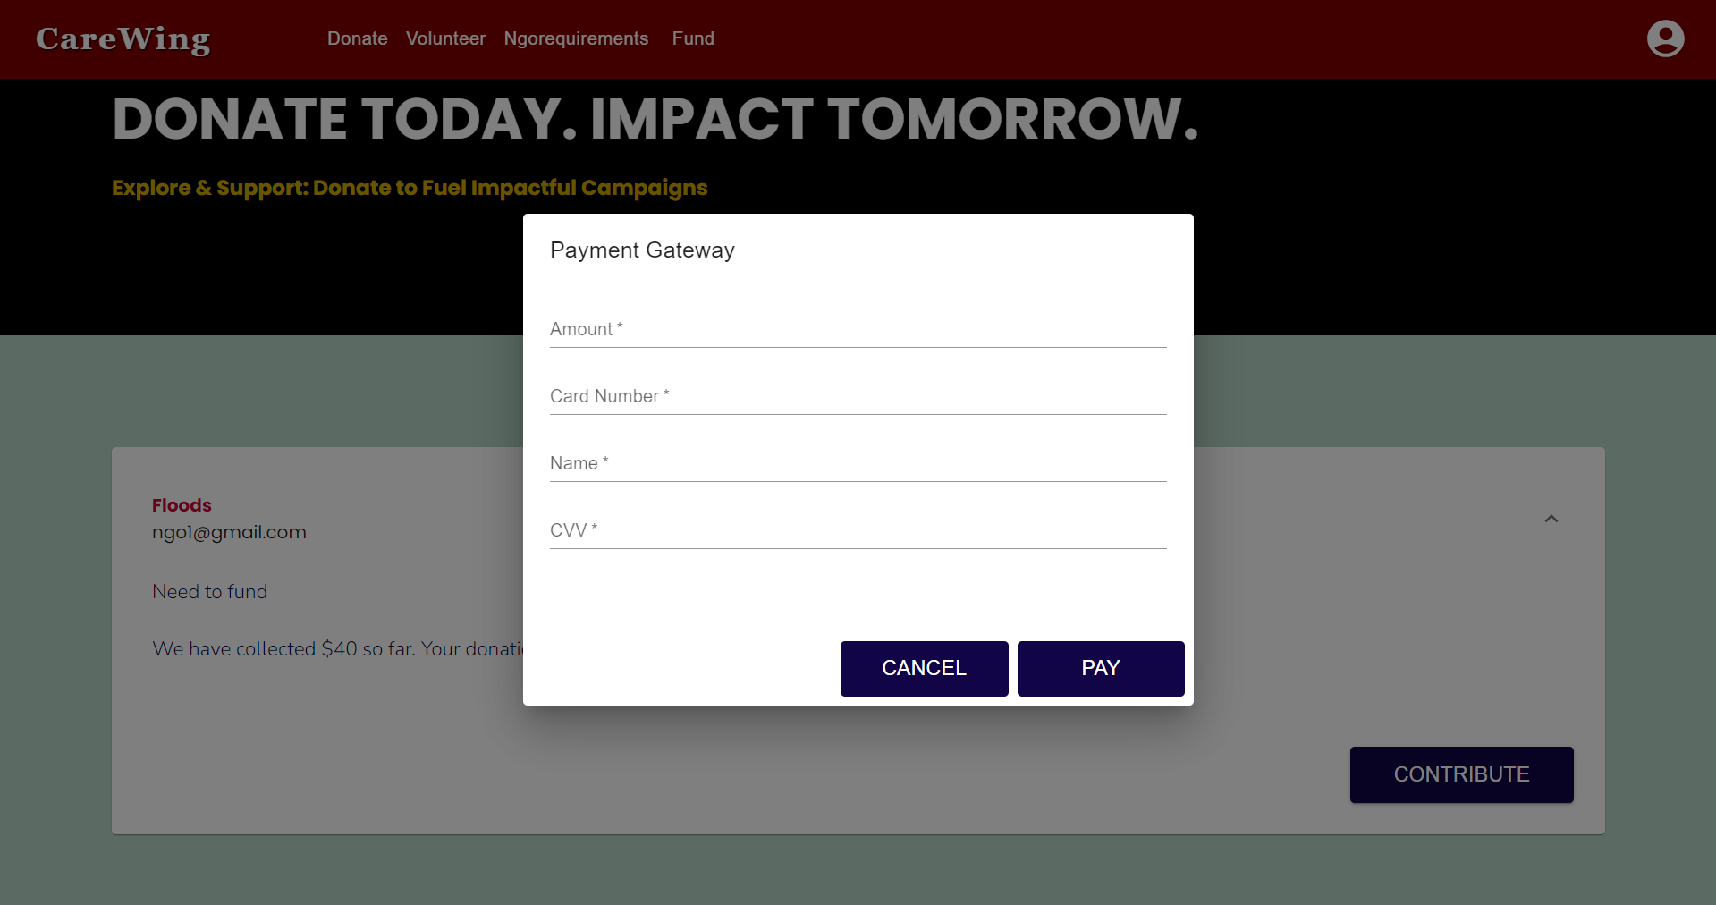

Slide 14
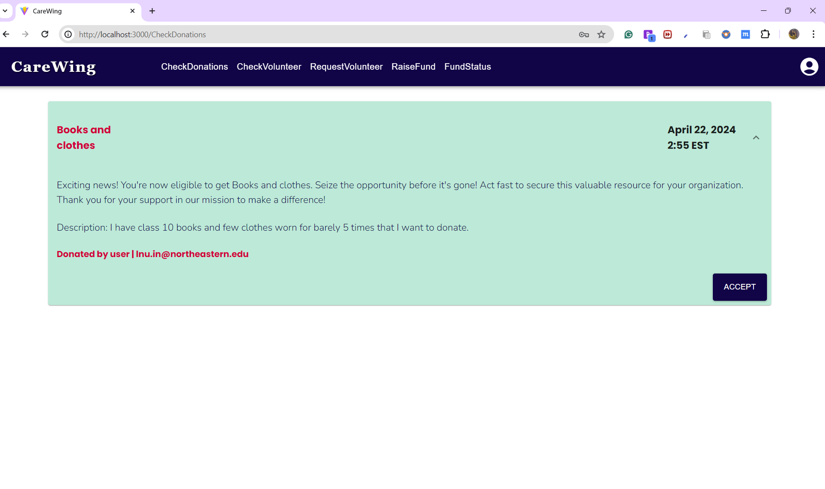

Slide 15
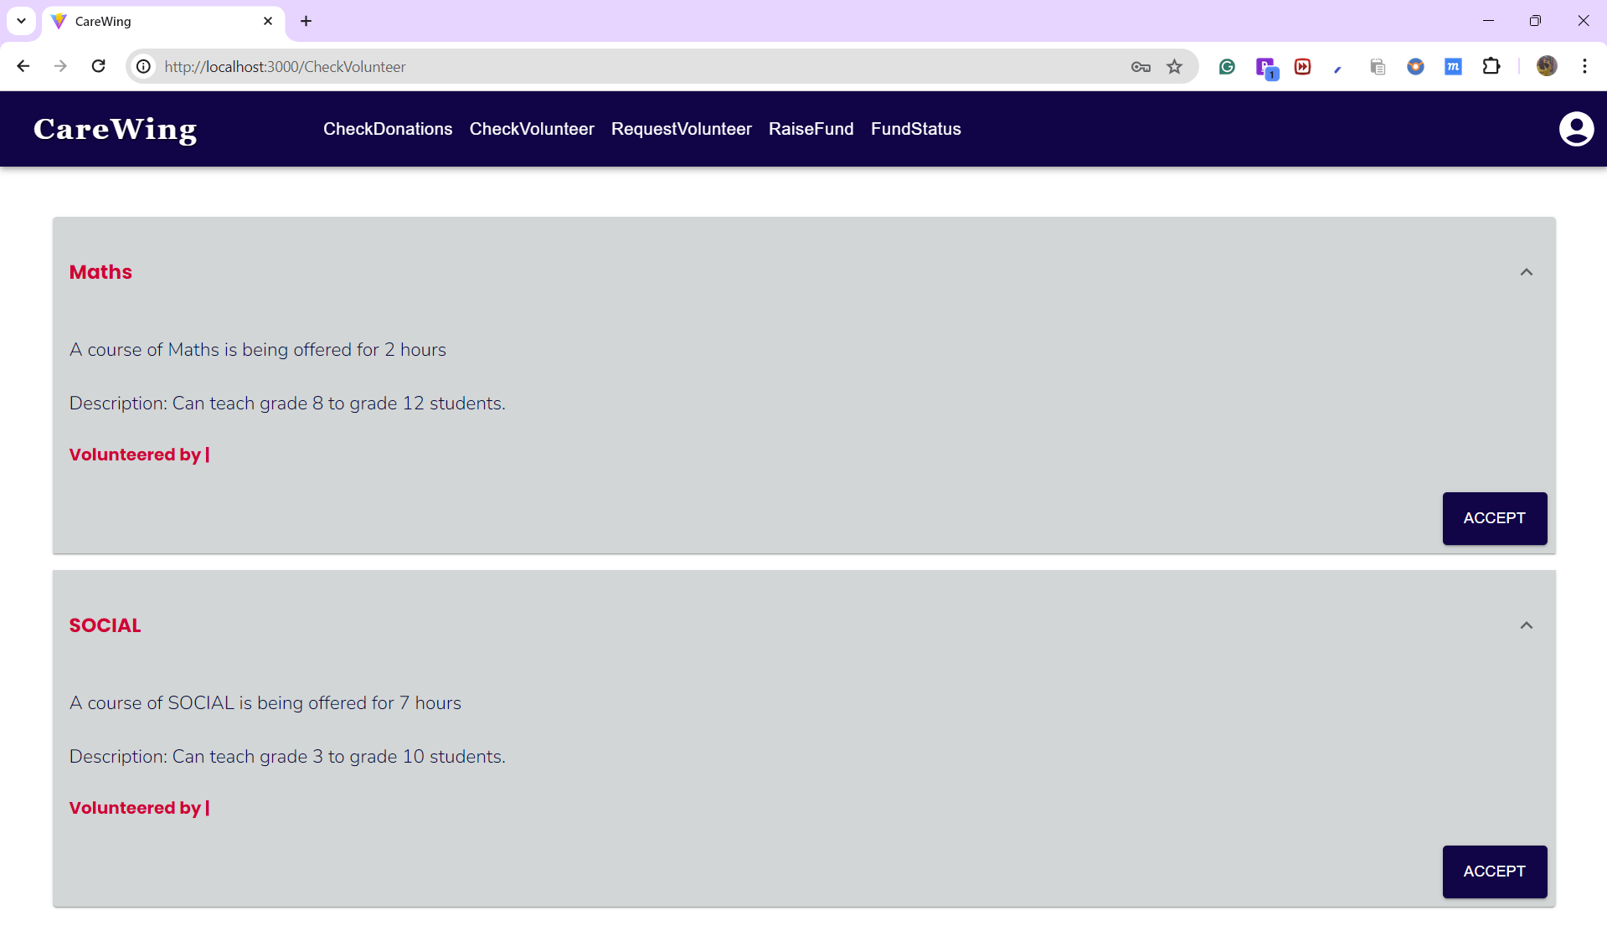

Slide 16
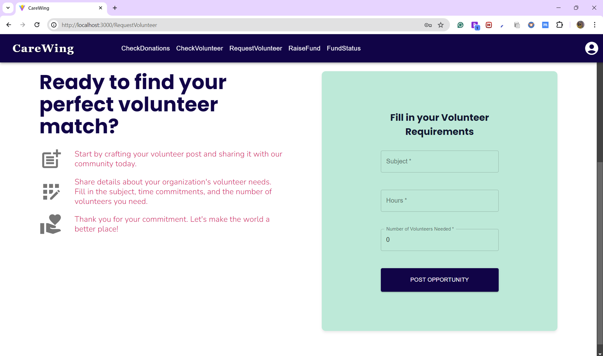

Slide 17
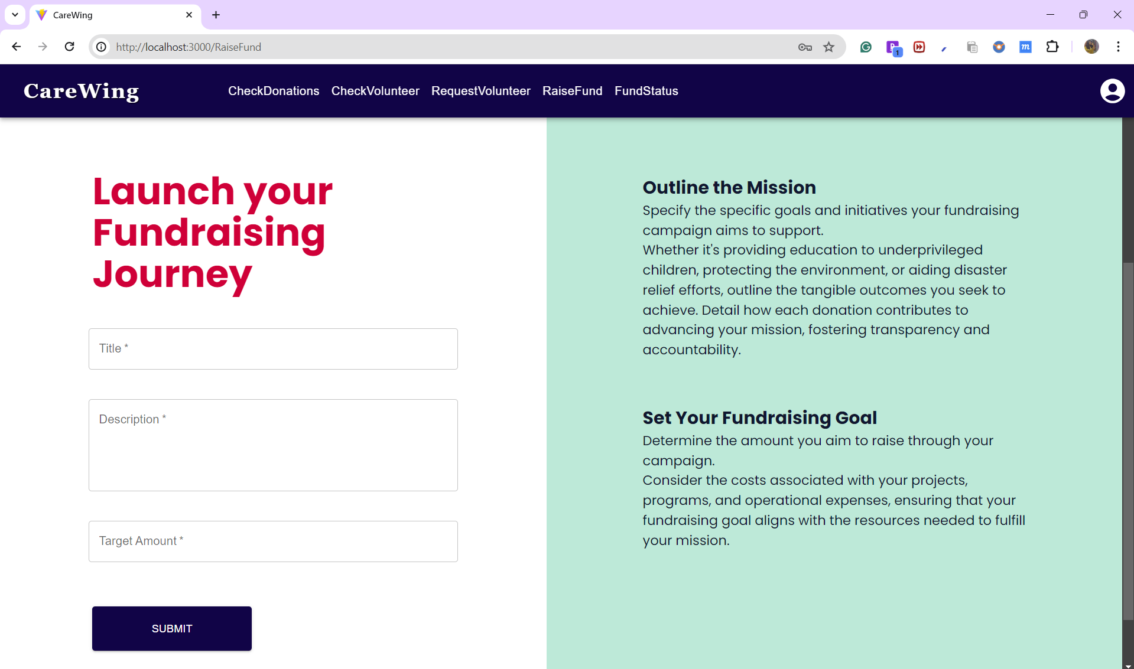

Slide 18
